Slide 1
CHEMISTRY –CLASS XII
UNIT XII-ALDEHYDES, KETONES AND CARBOXYLIC ACIDS
PART-I
[ Aldehydes and ketones: Nomenclature, preparation and physical properties ]

Slide 2
Outline
Review of previous session
Reactions of aldehydes and ketone
1) Nucleophilic addition reactions-Mechanism,Reactivity and
important examples
2) Reduction-a)Reduction to alcohols b)Reduction to hydrocarbons- Clemmensen and Wolff-Kishner reduction
3) Oxidation a) Oxidation by using strong oxidizing agents
b) Oxidation by mild oxidizing agents-Tollen’s reagent and
Fehling’s reagent
c) Oxidation of methyl ketones / aldehydes
(containing CH3CO group) and alcohols containing
CH3CH(OH) group
R O PUNE

Slide 3
Outline……..
4) Reactions due to α-hydrogen
a) Aldol condensation
b) Cross aldol condensation
5) Other reactions
a) Cannizzaro reaction
b) Aromatic electrophilic substitution reaction
(Nitration)
Uses of aldehydes and ketones
R O PUNE

Slide 4
Review of previous session
Let us recall the basic concepts from the present unit such as structures and names of aldehydes and ketones,
important preparation methods of aldehydes and ketones including the name reactions such as Rosenmund reduction, Etard reaction, Stephen reaction, Gatterman – Koch reaction etc.
Also we have covered the comparative study of the physical properties of aldehydes and ketones
In this session we are discussing the chemical properties of aldehydes and ketones
R O PUNE

Slide 5
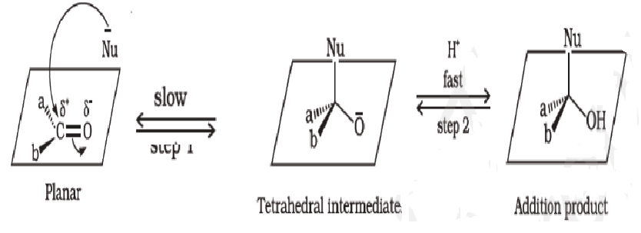
1. Nucleophilic addition reactions
Mechanism
Reactivity Aldehydes are more reactive than ketones in nucleophilic addition reactions.The reactivity of ketones is lower than aldehydes due to
i) Steric effect of two alkyl/aryl groups and
ii) Electronic effect i.e.+ Inductive effect
R O PUNE

Slide 6
Nucleophilic addition reactions…….
Addition
of HCN
b) Addition of
NaHSO3
R O PUNE

Slide 7

Nucleophilic addition reactions…….
c) Addition of RMgX
R O PUNE

Slide 8
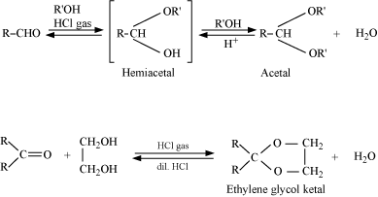
Nucleophilic addition reactions…….
d) Addition of R-OH
R O PUNE

Slide 9
Nucleophile addition reactions……….
e) Addition of Ammonia and It’s derivatives
R O PUNE

Slide 10
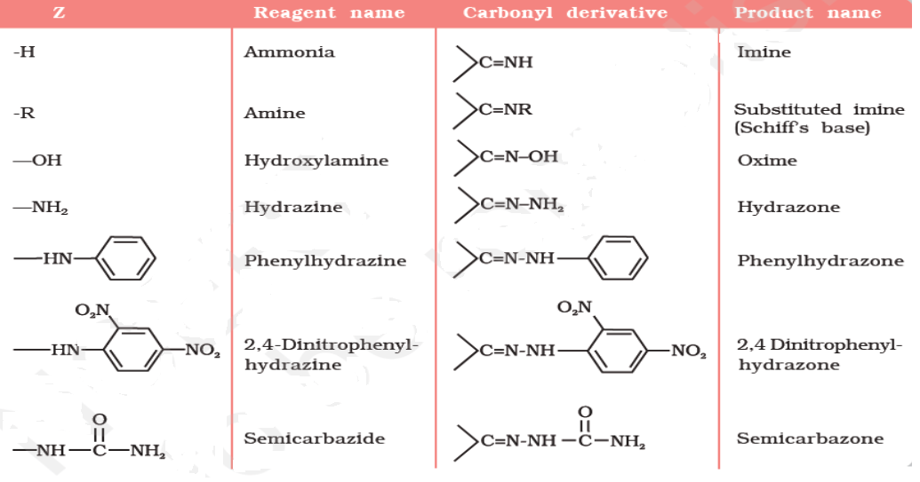
Nucleophilic addition reactions……….
Addition of Ammonia and It’s derivatives
R O PUNE

Slide 11
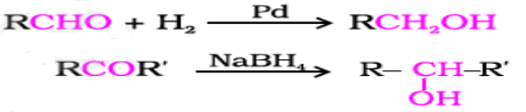
2. Reduction
a) Reduction to alcohols
b) Reduction to hydrocarbons
i) Clemmensen reduction
ii) Wolff-Kishner reduction
R O PUNE

Slide 12
3. Oxidation
Oxidation of aldehydes:
Oxidised by common oxidising agents such as KMnO₄, HNO₃, K₂Cr₂O₇, etc. also oxidised by mild oxidising agents such as Tollen’s reagent and Fehling’s reagent.
R O PUNE

Slide 13
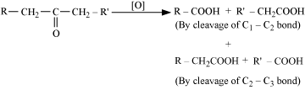
3. Oxidation
Oxidation of ketones:
oxidised under vigorous conditions, i.e., by strong oxidising agents and at elevated temperatures.
R O PUNE

Slide 14

Oxidation……..
Tests used to distinguish aldehydes from ketones
Tollen’s test
Fehling’s Test
R O PUNE

Slide 15
Oxidation……..
Haloform test for methyl ketones and the compounds with CH3CO or CH3CH(OH) units
R O PUNE

Slide 16


Slide 17
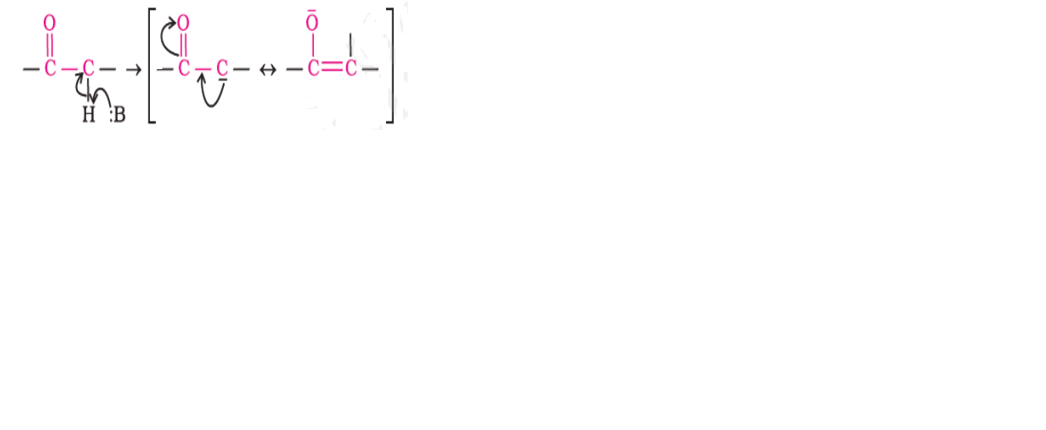
4.Reactions due to α-hydrogen
The acidity of α-hydrogen atoms of carbonyl compounds is due to resonance stabilization of the conjugate base.
R O PUNE

Slide 18
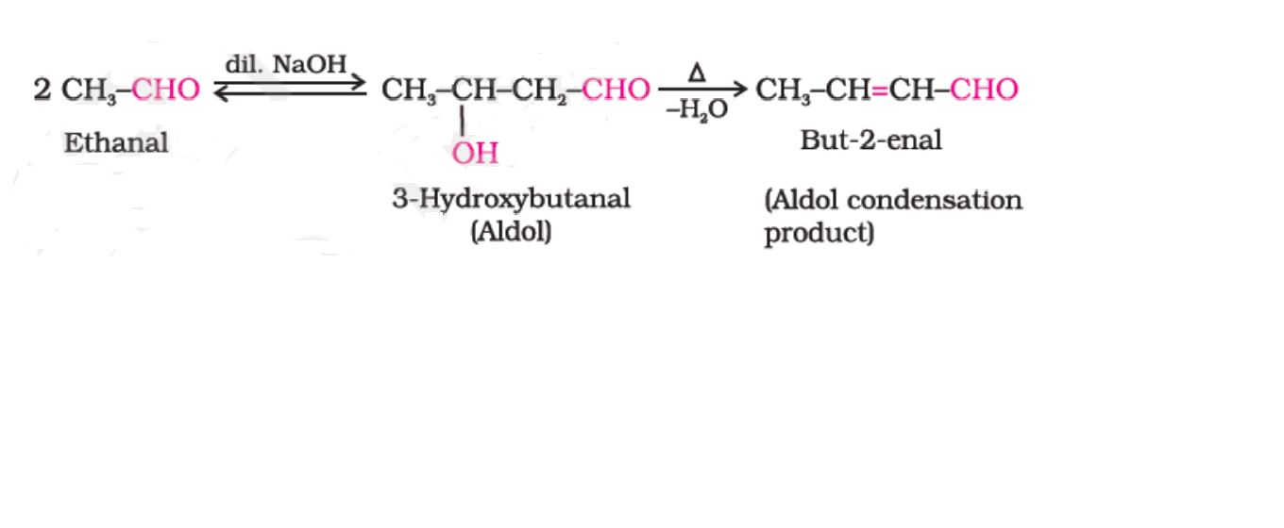
4.Reactions due to α-hydrogen
a) Aldol condensation
R O PUNE

Slide 19
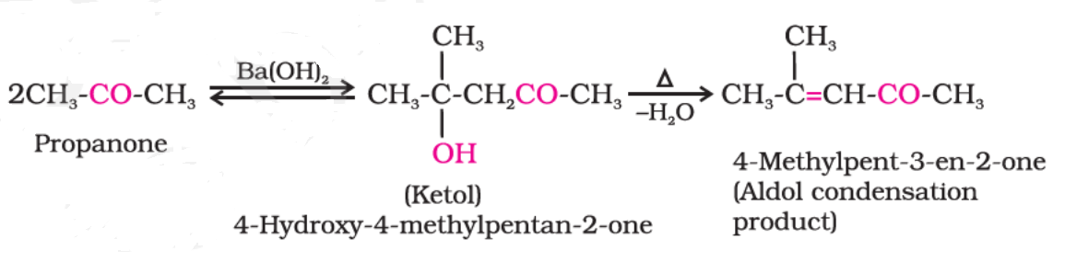
4.Reactions due to α-hydrogen
a) Aldol condensation
R O PUNE

Slide 20
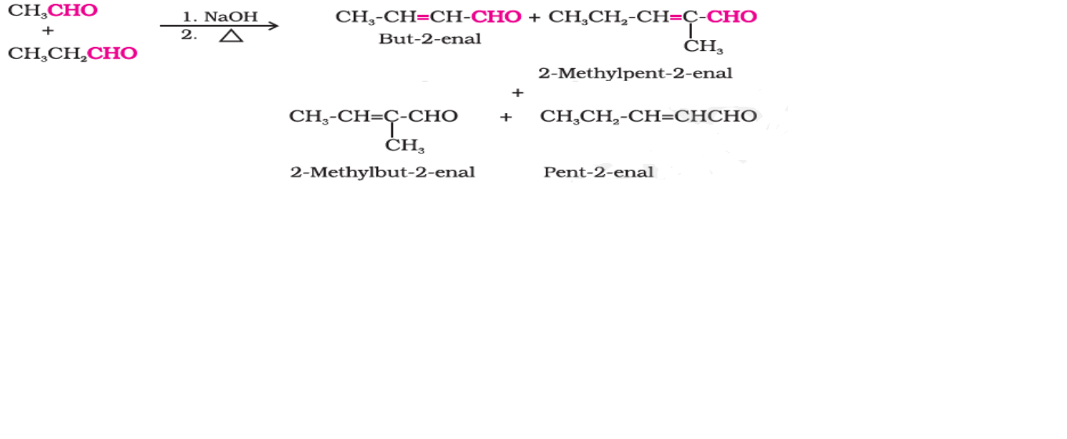
Reactions due to α-hydrogen………
a) Cross Aldol condensation
R O PUNE

Slide 21
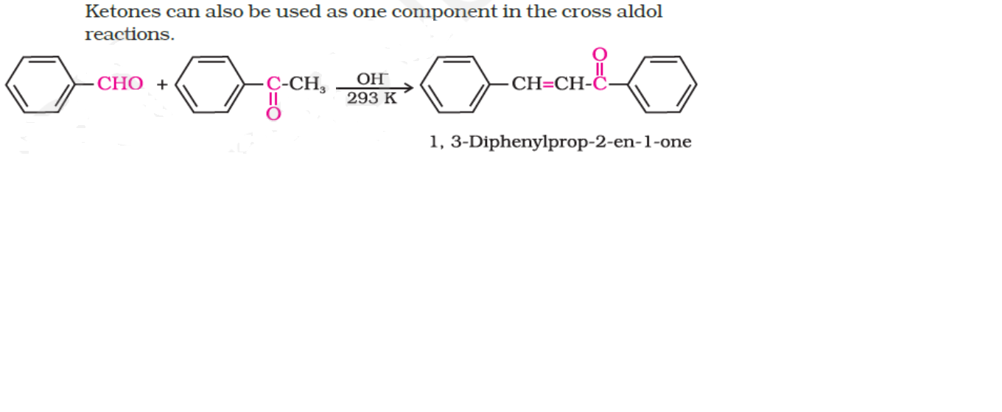
Reactions due to α-hydrogen………
a) Cross Aldol condensation
R O PUNE

Slide 22
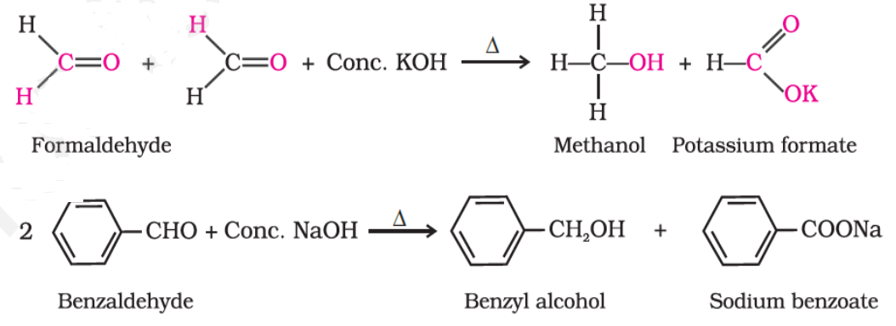
Other reactions
a) Cannizzaro reaction
R O PUNE

Slide 23
Other reactions…….
b) Aromatic electrophilic substitution reaction (Nitration)
R O PUNE

Slide 24
Uses of aldehydes and ketones
Used as solvents
Formalin (40% formaldehyde) –used as preservative for biological specimens
formaldehyde is used to prepare bakelite
Acetaldehyde is used to prepare acetic acid
Benzaldehyde is used in perfumery and in dye industries.
Acetone and ethyl methyl ketone are common industrial solvents.
Many aldehydes and ketones, e.g., butyraldehyde, vanillin, acetophenone, camphor, etc.are well known for their odours and flavours.
R O PUNE

Slide 25
Summary
In this session we have studied
the important reactions of aldehydes and ketones such as nucleophilic addition reactions,reduction,oxidation,Aldol and cross aldol condensation, Canizzaro reaction etc.
Also we have covered the important uses of aldehydes and ketones
R O PUNE

Slide 26
Thank you

